Slide 1

Technical Writing
Presented by
Bobby Pelphrey
Writing & Communications Center

Slide 2
Objectives
After today’s presentation, you will be able to:
Revise your writing for clarity, conciseness, and correctness
Avoid “credibility killers”
Understand the basics of technical writing

Slide 3
Why do STEM & business majors
need to write well?

Slide 4
STEM students write for three main purposes:
To analyze
To recommend
To control
Types of writing:
Design reports
Lab reports
Literature reviews
Bid evaluations
Feasibility studies
Notes:
Analyze situations, problems, or solutions and communicate those findings to peers and colleagues
Communicate suggestions and recommendations
To communicate specifications, rules, and

Slide 5
Technical Writing
Is clear and precise
Focuses on the expectations, goals, situations and needs of its intended readers
Builds trust between colleagues
  Technical Writing is not
  Wordy
  Poorly written
  “Just sufficient”

Slide 6
Technical Writers Always Consider
Purpose (why you are writing)
Audience (who will read the document)
Stakeholders (who may be affected by the document or project)
Context (the background of and situation in which the document is created)

Slide 7
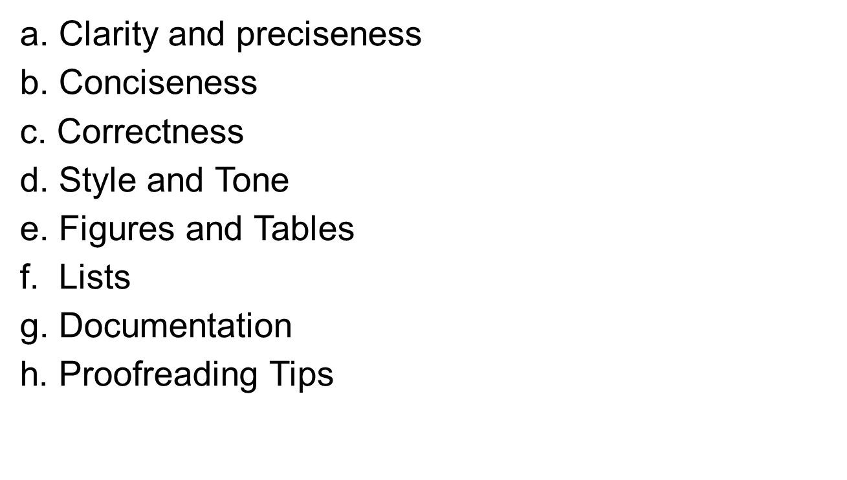
Technical Writing

Slide 8
a. Clarity & Preciseness
Clarity ensures that the reader understands your writing without any difficulty. This means the writing:
  Shows a clear grasp of vocabulary, jargon, and standard grammar and punctuation.
  Follows a logical and predictable organization.
  Preciseness means using specific word choices and avoiding vague words.
  The current remained increased for several hours.
  VS
  The current remained increased for 6 hours.

Slide 9
  Clarity cont.
The office of the Secretary of Defense, Rapid Reaction Technology Office (RRTO), is sponsoring a student design, build, and demonstrate project to explore how effectively motivated, intelligent persons with just a general background in engineering (role filled by undergraduate students), with modest resourcing, and in a relatively short period of time, provide an underwater vehicle capable of locating potential unexploded ordnance (UXO) of discarded sea mines.
Notes:
Sample of student writing – read out loud
What is wrong with the sentence?
This sentence is jam packed with information, and that can potentially confuse your reader.

Slide 10
  Clarity cont.
Revised
The Rapid Reaction Technology Office (RRTO), a subdivision of the Office of the Secretary of Defense, is sponsoring a student design project in order to create an underwater vehicle that explores for unexploded sea mines.
Subject: RRTO
Verb: is sponsoring
Significance: student design project in order to create an underwater vehicle that explores for unexploded sea mines.
Notes:
For an introduction to the project, we would recommend that the group revise this sentence so that the subject performs an action for a specific reason.
Revising this for clarity would involve cutting the sentence down to its bare essentials, including only that information that is necessary: the subject, the verb, and the significance (what the subject is doing). Everything else just gets in the way. This highlights another key trait of technical writing (transition to conciseness).

Slide 11
  b. Conciseness
Conciseness means that extraneous words, phrases, clauses, and sentences have been removed/shortened without sacrificing clarity or appropriate detail.
Causes of Wordiness:
  Redundant Modifiers
    basic fundamentals, final outcome, completely finished, present status, red in color, future plans, main essentials, reason is because, cold temperature, true facts
  Excessive qualification
  perfectly clear, completely accurate, completely eliminate, still persists

Slide 12
  Conciseness Cont.
    Redundant words and ideas
      Key difficulties of the project include constraining the broad project scope, designing a system to operate under varying ocean conditions, and designing a system to conform to SOCOM’s mission goals.
      The system uses several flotation devices along the top of the system to ensure that it will float.

Slide 13
  Conciseness cont.
Overuse of pronouns (there, it, who/whom, that, which), often resulting in lengthy, indirect, and unclear expression of ideas
  After a talk with some advisors our group has decided that the best option for this group would be to redefine our scope and come up with a centralized plan that would allow for more specified designs that would be both feasible and matching our objectives for the project.

Slide 14
  Conciseness cont.
Unnecessary Phrases and words
There are many papers stating… | It is speculated that…
It was shown to… | It has been found that…
It was observed that… | It has been demonstrated…
It is reasonable to assume that… | It has been reported that…
Evidence has been presented that shows that… | It has been long know that…
In a previous study, it was demonstrated that heavy metals can be removed from aqueous solutions by sawdust absorption. VS
Heavy metals can be removed from aqueous solution by sawdust absorption.

Slide 15
  Conciseness cont.
Unnecessary Words
Actually | Basically
Essentially | Fairly
Much | Really
Practically | Quite
Rather | several
Very | Virtually
Most –ly adverbs can be omitted because they add nothing to a text.

Slide 16
  Conciseness cont.
Phrases that can be shortened include:
Avoid | Better
A considerable number of | Many
In some cases | Sometimes
Utilization | Use
It is of interest to note that | Note that
As a consequence of | Because
Due to the fact that | Due to/because
During the time that | While, when
For the purpose of | To
With respect to | about
Majority of | Most
Prior to | Before

Slide 17
  Revise for Clarity & Conciseness
The aim of this project is to rejuvenate the mid­century modern styled Wesley J. Howe Center building located on the Stevens Institute of Technology campus in Hoboken, NJ. The 174 foot tall, 14 story building, completed in 1962 is the epicenter of the Stevens Campus and is in need of some exterior and interior updates. When this building was originally designed, “value engineering” principles were used in order to cut cost and save time and money. After over 50 year of service these cost cutting measures are very evident and starting to become problematic. The goal of this project is to make this building into a modern, state of the art, uniquely styled monument that is a beacon to represent the technologies and innovations that Stevens is famous for. With the use of new energy efficient systems and advanced construction materials the Howe Center Team hopes to increase the value and appearance of one of the largest and most valuable buildings and assets on the Stevens Campus. This goal will be achieved with the help and guidance of the project sponsor Tishman Construction by completing a “Building Repositioning” on the Wesley J. Howe Center. (195 words)
Notes:
From the Introduction of a student work from last year.
Pass out handout
Read through this. How could we revise this?

Slide 18
The 174-foot-tall, 14 story Wesley J. Howe Center is the epicenter of the Stevens Institute of Technology campus in Hoboken, New J. Built in 1962, its designers used “value engineering” principles to save time and money, but these measures led to problems. The building now needs exterior and interior updates. The Howe Center Team hopes to rejuvenate the building via the use of energy efficient systems and advanced construction materials. Project sponsor Tishman Construction will support the team by completing a “Building Repositioning” on the Center.
(85 words)
Notes:
Revised version, 90 word.
Cut out unnecessary details, flowery language, repetitious phrases, redundant modifiers, and typos.
Synthesized multiple sentences.

Slide 19
c. Correctness
Correctness (and a writer’s credibility) is determined by many aspects of a writing project, including use of tables and figures and documentation of source material.
Credibility is damaged by inaccurate expression of ideas via word choice and grammatical construction.
The most common of credibility killers include misused words, misspellings, and incorrect verb tenses.

Slide 20
Correctness Cont.
Misused Words
Significant(ly) | Use only when talking about statistical significance | Use: important, substantial, markedly, meaningful, and notable
Since | Use only in its temporal sense | Ex. Growth stopped since temperature fell below freezing.
Because | Indicates causality | Ex. The reaction rate decreased because the temperature dropped.
Affect vs. Effect | Affected used as a verb meaning to act on or influence; effect used as a noun meaning a result. | Ex. The addition of KI-3 to Mz1 cells affected their growth rate. Ex. The effect lasted several minutes

Slide 21
Correctness Cont.
Avoid Sexist Language
While often unintentional, some forms of sexist language are so subtle that authors might over look them. For that reason, always use gender-neutral language to convey inclusion and equality.
EX. Mankind has faced many plagues over the centuries.
VS
Humans have faced many plagues over the centuries.
EX. The doctor reviews his notes before making a diagnosis.
VS
Doctors review their notes before making a diagnosis.

Slide 22
Correctness Cont.
Grammar
Parallel structure: Lists and ideas that are joined by a conjunction (and, or, but) are treated equally by writing in parallel form.
Not Parallel:
    The production manager was asked to write his report quickly, accurately, and in a detailed manner.
Parallel:
    The production manager was asked to write his report quickly, accurately, and thoroughly.

Slide 23
Correctness Cont.
Tenses
General rules :
Use past tense for observations and specific conclusions.
Use present tense for general rules and established knowledge.
EX. Higher temperatures resulted in less bud formation.
NOTE: Tenses may vary from one section of the paper to the next; they can also vary within a paragraph.

Slide 24
Correctness Cont.
Tenses cont.
Concept Generation/Selection: Past tense (rationale for selection process happened it the past)
Technical Analysis: Combination of tenses to highlight past research and future directions
Project Plan: Future tense
Discussions / Conclusions: Combination of tenses to highlight past research and future directions

Slide 25
  d. Style and Tone Cont.
Passive voice is generally used to show the following:
The actor is unknown: The cave paintings of Lascaux were made in the Upper Old Stone Age.
The actor is irrelevant: An experimental solar power plant will be built in the Australian desert.
The main topic is the thing being acted on: Insulin was first discovered in 1921 by researchers at the University of Toronto. It is still the only treatment available for diabetes.

Slide 26
  Style and Tone Cont.
First Person: I, we
Third Person: it, he, she, they
Most proposals, academic writing, scientific reports, and professional writing are written in the passive third person voice.
  PASSIVE: The sodium hydroxide was dissolved in water. This solution was then titrated with hydrochloric acid.
  NOT
  ACTIVE: We dissolved the sodium hydroxide in water and then titrated the solution with hydrochloric acid.
If you are uncertain, defer to advisors or style guides.

Slide 27
  e. Figures and Tables
When using figures and tables:
  Write clear and informative titles
  Ensure that they are self-explanatory
  Number figures and tables
  Place in the document close to the written reference
  If you have more than 5 figures or tables, create a section following the table of contents titled “List of Figures” or “List of Tables”

Slide 28
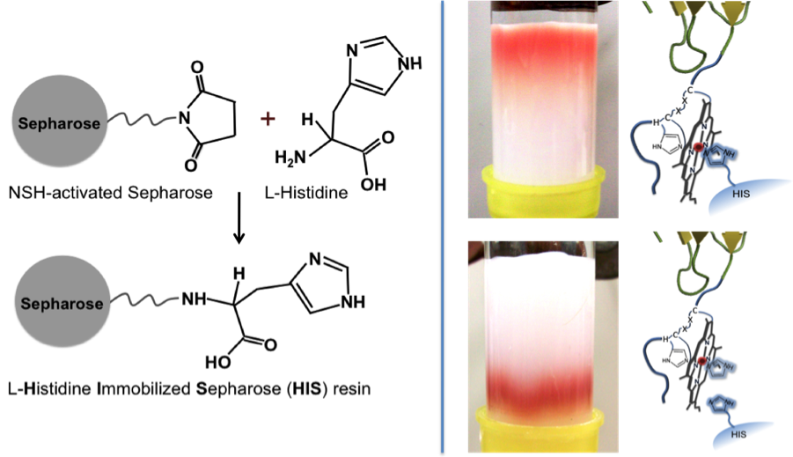
Figures and Tables Cont.
Figure 1. L-Histidine bound Peptide
Place the figure number and title at the bottom of the figure.

Slide 29
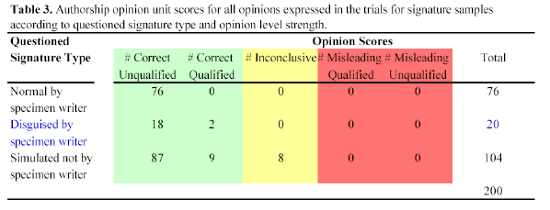
Figures and Tables Cont.
Place the table number and title at the top of the table.
Notes:
Clearer example for student.

Slide 30
f. Lists
When using bulleted lists:
Write an introductory sentence to explain what the list will contain (such as project specs), followed by a colon.
Capitalize the first word in each listed item unless doing so is visually awkward.
Write the listed items in parallel grammatical structure.

Slide 31
  g. Documentation
Document any and all ideas or words you take from sources. This includes:
  Anything that is not general knowledge
  Any words or ideas taken from another source
  Any facts, statistics, figures or tables that come from someone else’s research
  Anything that has been copy-and-pasted

Slide 32
Documentation Cont.
All citations have two parts:
  in-text citation
  reference page
The in-text citation should clearly cross-reference with the entry on the reference page.
Required Information (what anyone can find and confirm the source):
  The author(s) who wrote the words.
  The page number, if applicable.
  Publication information (book or journal, year of publication, name of publishing company, etc.).
Notes:
Use the last name of the author or whatever appears first in the reference.
If there is no author, cite the publishing organization or the title of the work you are citing
If you are citing an essay in the anthology, the author is the person who wrote the essay, not the editor of the anthology.

Slide 33
Documentation Cont.
Sample In-text Citations in APA style:
According to Jones (1998), "Students often had difficulty using APA style" (p. 199).
She stated, "Students often had difficulty using APA style" (Jones, 1998, p. 199), but she did not offer an explanation as to why.
Notes:
Use the last name of the author or whatever appears first in the reference.
If there is no author, cite the publishing organization or the title of the work you are citing
If you are citing an essay in the anthology, the author is the person who wrote the essay, not the editor of the anthology.

Slide 34
Documentation Cont.
Sample Reference Page entries in APA style:
Calfee, R. C., & Valencia, R. R. (1991). APA guide to preparing manuscripts for journal publication. Washington, DC: American Psychological Association.
Harlow, H. F. (1983). Fundamentals for preparing psychology journal articles. Journal of Comparative and Physiological Psychology, 55, 893-896.
United States Department of Housing and Urban Development. (2008). Indiana income limits [Data file]. Retrieved from http://www.huduser.org/Datasets/IL/IL08/in_fy2008.pdf

Slide 35
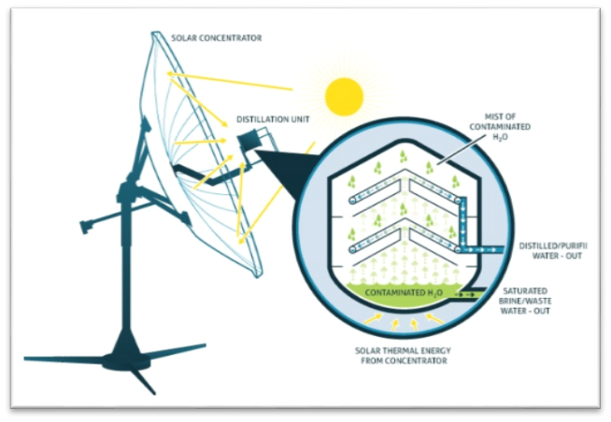
Documentation Cont.
  Tables and Figures that are not your own must be documented.
  For example, the reference page entry for this figure is:
  “Solar Water Treatment.” Epiphany Solar Water Systems. Epiphany Solar Water Systems, n.d. Web. 31 Oct. 2013.
Fig. 1 Description (“Solar Water Treatment”)
Notes:
Only cite the person who wrote the words! Do no assume that someone wrote the words because they are the CEO of the company. If it is not clear who the author is, use the article title or the organization instead.

Slide 36
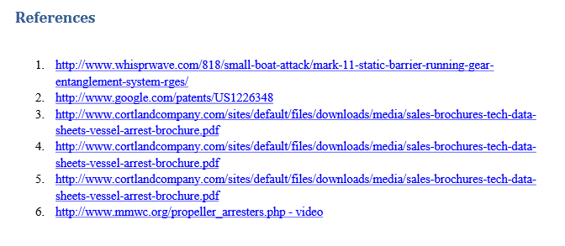
Documentation cont.
What’s wrong with this reference page?

Slide 37
h. Proofreading Tips
Read your work backwards.
Read your work aloud.
Always proofread a printed version.
Give yourself some time.
Get others involved.
Identify the errors you typically make and learn to correct them.
Do not trust spell check or grammar check programs.

Slide 38
For free help with:
Essays
Journal publications
Cover letters & resumes
Presentations
Interview preparation
English conversation
Dissertations
Personal statements
and more.
Located in Morton 210
Open to all students at
Stevens
Find current hours and make an appointment at www.stevens.edu/cal/wcc

Slide 39
References
Alfred, Gerald J., Charles Brusaw, & Walter Oliu. Handbook of Technical Writing, 10th ed. Boston: Bedford/St. Martins, 2012.
Hofman, Angelika. Scientific Writing and Communication: Papers, Proposals, and Presentations, 2nd ed. New York: Oxford University Press, 2014
Robert, Irish. Writing in Engineering: A Brief Guide. New York: Oxford University Press, 2015.

